Slide 1


Unlocking AI Performance with NeMo Curator: Scalable Data Processing for LLMs
Ayush Maheshwari Sr. Solutions Architect, NVIDIA https://github.com/ayushbits/llm-development ayushbits.github.io
Notes:
Key takeaways:
Data Processing for LLMs at scale needs accelerated computing
paths - custom pipelines with RAPIDS and NeMo Curator
Zero code change for custom pipelines

Slide 2
Sessions
Large scale data curation for LLM training
Large scale data curation for LLM training (1 hour)
Understanding the hardware (30 mins)
GPU vs CPU
GPU communication primitives
System Topology
Large scale data curation for LLM training (1 hour)
Deep-dive into aspects of data curation
Mixed-precision training
BREAK (10 mins)
Distributed and stable LLM training on a large-scale cluster (1 hour)
Parallelism techniques
Frameworks and wrappers
Recipes and best practices
Inference (15 mins)
Inference with build.nvidia.com
Synthetic data generation

Slide 3

Register for GTC 2026
https://tinyurl.com/nvgtc2026
Scan QR

Slide 4
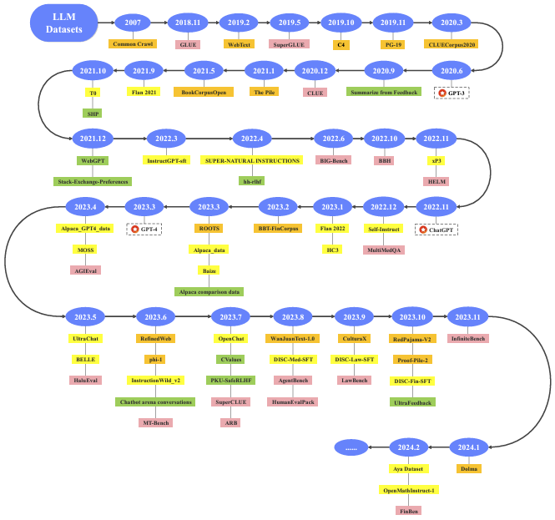
LLMs Are Trained on Internet Scale Data
Data generated is growing exponentially
Training corpa
Instruct fine tuning
Preference dataset
Evaluation dataset
https://arxiv.org/abs/2402.18041
Notes:
Before we dive in, let’s see why we need to have data processing at scale just from the data standpoint. If you look at the evolution of LL models, this is an image from the survey paper, there is a link at the bottom left.
In 2007, common crawl dataset is the only large dataset available for doing research because that’s the only large dataset we have,
as we went through the years, the amount of dataset to train LLMs keeps growing, and we not only have training corpus, we also have instruct-fine tuning, preference dataset, evaluation dataset.
After 2023, this kind of dataset kept growing, thus we need techniques/methods that are GPU-accelerated, so the overall data processing pipelines become efficient to process data at scale.

Slide 5
LLM model stages (usual)
Pre-training
Model adaptation/tricks
SFT/RLHF
PEFT
Inference
Usually has no ability to perform 0-shot instruction following.
Good for sentence completion/paragraph.
Can be base model for Parameter Eficient Fine-Tuning (PEFT) or Supervised Fine-Tuning (SFT)/RLHF.
UL-2.
Distillation.
Domain adaptation.
Context Length expansion.
Supervised Fine-Tuning for instruction following.
RLHF for better subjective alignment.
Usually SFT gives ability, RLHF gives tone/nuances.
PEFT can be done directly from pre-trained model or from an SFT model.
LLM Service: base model is SFT already.
Adds abilities not covered in standard SFT at a very low computational cost.
Few-shot.
Prompt engineering.
“Prefix engineering”.
Special tokens tricks etc.
Notes:
UL2: https://ai.googleblog.com/2022/10/ul2-20b-open-source-unified-language.html

Slide 6
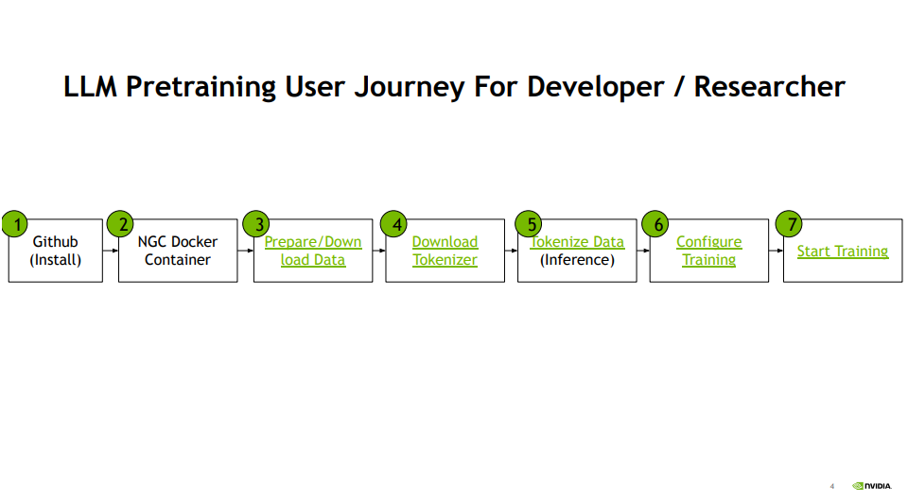

Slide 7

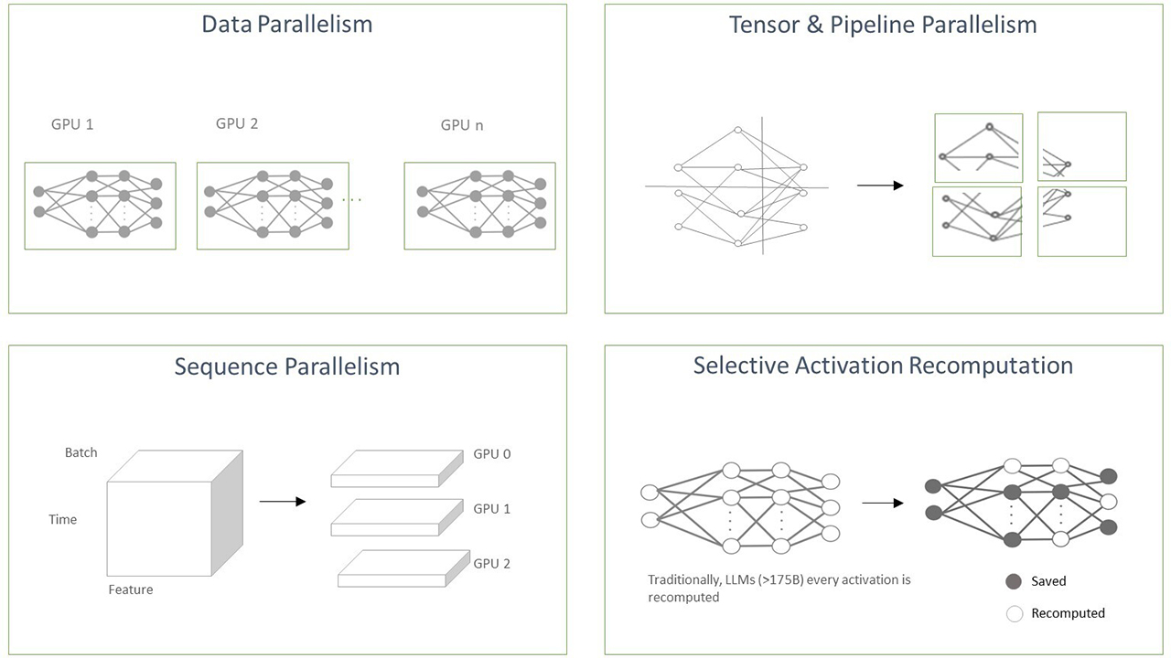
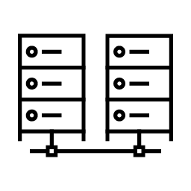

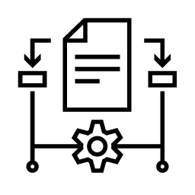
Building Generative AI Foundation Models
Efficiently and quickly training models using NeMo
Challenges of Building Foundation Models
Accelerated Training With NeMo
Mountains of Training Data
Large-scale compute infrastructure for training & inferencing, costing $10 M+ in just cloud costs
Deep technical expertise
Complex algorithms to build on large-scale infrastructure
Data Curation Tool
Accelerated Training
Large Datasets
Deduplication
Extract Language
Blending
Filtering
Curated Dataset
Tensor & Pipeline Parallelism
Accelerated Training
Accelerated Training
Sequence Parallelism
Selective Activation Recomputation

Slide 8


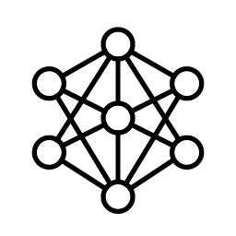
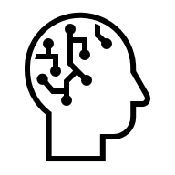
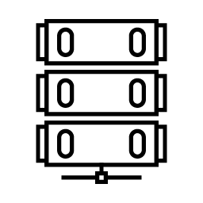



Requirements for Building Custom LLMs
Training Data |  | Accelerated Computing |  | Training and Inference Tools |  | AI Expertise
Notes:
While generative AI shows tremendous promise for delivering business value, entering this complex domain can be tricky and full of pitfalls.
There are significant investments that companies must make to build custom LLMs to meet their needs.
Building custom LLMs requires massive amounts of training data. To get these models to understand, predict, and create human-like text, we need to feed them with a colossal corpus of diverse and high-quality data that has been carefully curated and sanitized.
Once the data is ready, training an LLM requires thousands of GPUs and weeks to months of dedicated training time. It’s not uncommon for this step of the process to run over ten million dollars in compute cost.
Implementing LLMs is not only about having the right hardware- it's also about having the right software. Companies need tools and platforms to optimize the training process and accelerate inference on distributed infrastructure once the models are deployed in production.
Adapting an LLM to reflect a specific task or knowledge area requires fine-tuning and customizing the model with additional domain specific data. This requires constant feedback from data scientists and engineers with a deep understanding of AI and statistical learning. This expertise can be difficult to find and retain in this competitive market.
Building custom LLMs is no easy task – it’s a costly and complicated process which has left many enterprises not knowing where to start.

Slide 9




NVIDIA NeMo Framework
OSS libraries for pre-training, post-training, and reinforcement learning of multimodal models at scale
Data Curation
Pre-training & Fine-tuning
Post-training & Reinforcement Learning
Inference
NeMo Curator
Megatron Bridge (Megatron backend)
Automodel (PyTorch backend)
NeMo-RL (Megatron & PyT backend)
Export-Deploy
Evaluator
Guardrails
Performance & Scalability Supports training over 16k+ GPU clusters with advanced 4-D parallelism & 1M+ long context window support
Multi-modal 23 model families across LLM, SSMs, MOEs, Speech models, VLMs, WFMs
SOTA Algorithm PEFT, PEFT: LoRA, p-tuning, QLoRA, Model alignment: RLHF PPO, DPO, KTO, IPO, RLAIF, SteerLM, etc
Usability & Compatibility
Ease of use with Hugging-face like pythonic APIs and fault tolerance to ensure smooth training

Slide 10

Megatron Bridge and Automodel
Enhanced Developer experience with modular API
Megatron bridge
Target User: Advanced Research/Production
Pythonic configuration
With Megatron Core as backend, access to Megatron-Core’s most optimized kernels, advanced parallelism options
Production-grade recipes optimized for high-throughput and efficient large model training
Automodel
Target User: Fast Prototyping/Experimentation
YAML file configuration
PyTorch as backend
Rapid, out-of-the-box fine-tuning and training for any Hugging Face model, prioritizing plug-and-play ease, speed, and compatibility

Slide 11
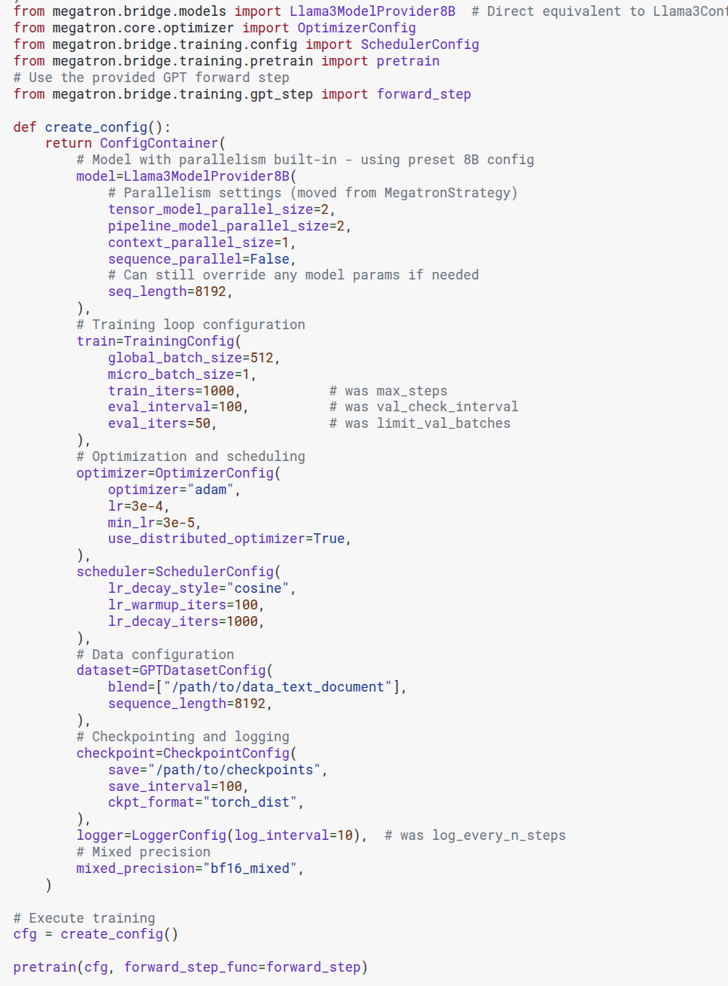
Megatron Bridge Modular code for pre-training
Parallelism settings
Training loop settings
Optimizer
Scheduler
Dataset
Checkpoint & logging
Notes:
Example of fine-tuning with AutoModel, too big to fit the slide:
https://docs.nvidia.com/nemo/automodel/latest/guides/llm/finetune.html#recipe-config

Slide 12
Data Processing for LLMs Needs Accelerated Computing
Petabytes of Data Generated Yearly
LLMs Trained on Internet Scale Data
Moore’s Law Has Ended
Compute FLOPs Pre-Transformer Era: 3000x in 5 Years
Compute FLOPs Transformer Era: 20,000x in 5 Years
10²⁵
Gemini 1.0 Ultra
Llama 405B
GPT-4
Llama-3 70B
AI
10²⁴
PaLM 2
Nemotron 340B
Minerva 540B
PaLM 540B
10²³
AlphaGo Zero
GPT-3 175B
Falcon 40B
10⁹
10²²
Meena
Skywork-13B
10⁸
SCALE
UP & OUT
10⁷
Data Generated (Zettabytes)
10²¹
Xception
GPT-2
10⁶
Training Compute (FLOPs)
AmoebaNet-A
10⁵
10²⁰
DeepSpeech2
10⁴
10¹⁹
10³
ACCELERATED
COMPUTING
VGG16
GPT-1
10²
1.1X per year
10¹⁸
ImageNet
10¹
10¹⁷
10¹⁶
1.5X per year
Single-threaded perf
2012
2016
2020
2024
Notes:
Before we dive in further, another aspect I would like to highlight, is to share amount of dataset we humans are producing.
If you look at the image on the left side, the amount of dataset we produce is exponentially growing into Petabytes, Petabytes = 1*10^28 bytes, we humans are producing enormous amount of data;
and because we have enormous amount of data, we start to create LLMs that are complex and have billions of parameters, as shown on the graph in the middle;
and from the graph on the right, you can see that we are still using libraries and frameworks that follows Moore’s law, such as pandas to process data but Moore’s law is no longer valid. Also, downstream training or fine-tuning foundation models is already sorted and GPU accelerated and optimized, but data processing step before training is not GPU accelerated. That may eventually become a bottleneck.

Slide 13







Data Processing for Different LLM Needs
v
Training Foundation Model
Fine-Tuning Foundation Model
Retrieval Augmented Generation (RAG)
Data Size | TB and PB | GBs | GBs
Compute Scale | Supercomputer | Single-node | Single GPU
Frequency | One-time | Iterative | Iterative & Continuous
Notes:
If you categorize LLM training or fine tuning, you can break it down into 3 bulks. For each of the 3 categories, the requirement on the dataset size varies depending on the use cases.
If you are training foundation model, the dataset size you are looking at is in terabytes or megabytes, for example, llama 3.1 uses 15 trillion tokens. Hence, the requirements on the computation power also changes. You may need a supercomputer. And how often are you training a foundation model, maybe once a while.
If you are fine-tuning a foundation model, the dataset size goes to upper GBs or lower megabytes, you can easily fine tune a model in a single-node and you may fine tune a model much more frequently for different use cases.
If you want to create a rag-based workflow, the documentation you keep adding on to your vector database is way more often, not daily, not weekly, maybe monthly, depending upon the application, if your application is for a specific software and you are adding new features to it, you can add that documentation to the workflow, but it can be much more intuitive than training or fine-tuning a foundation model, you can easily get it done on a single GPU.
Let’s get started on Training Foundation Model and the challenges out there.
-----------------------------------------------------------------------------------------------------------------------------------------------------------------------------------
CPU-based – Existing libraries rely on CPUs, leading to longer processing times
Fragmented – Developers build DIY fragmented solutions for different steps in data processing pipelines
Iterative jobs – Existing solutions process larger datasets iteratively instead of scaling efficiently.

Slide 14



Challenges with Existing Solutions for Training Foundation Models
Inefficiencies lead to higher TCO and slower time to market
Longer Processing Time
Un-optimized Models
Un-optimized Pipelines
Knowledge & Expertise
Notes:
If you are using CPU-based workflows, training foundation models at scale is incredibly demanding — and traditional solutions introduce several key bottlenecks:
First, training takes significantly longer, increasing both time-to-market and compute costs.
Second, many models are not optimized, leading to wasted resources and reduced accuracy.
Third, pipelines often remain fragmented or inefficient, slowing iteration and deployment.
And finally, the deep expertise required to tune, scale, and optimize these workflows creates a steep barrier for most teams.
All of this adds up to higher TCO and delayed innovation.

Slide 15




NeMo Curator - Overview
Scalable, configurable pipelines to curate text, image and video datasets lead to more accurate applications
Higher Accuracy
Faster Processing
Scalability
Classifier Models
Deploy anywhere
Improve accuracy with less data and less training compute
GPU acceleration with RAPIDS for Dedupe (Exact, Fuzzy, Semantic) and Quality Classifier Models
Up to 100+ PB data by scaling across multiple nodes
State-of-the-Art quality classifier NIM microservice for safety, content, and diversity
Python APIs in a customizable and modular OSS library, runnable across CSP and On-prem
GitHub
NeMo framework container
PyPI
Microservice
(coming soon)
Notes:
NeMo Curator is a scalable and configurable pipeline that helps curate text, image, and video datasets to power more accurate AI applications.
It enables higher accuracy by improving model performance with less data and compute.
Through GPU acceleration with RAPIDS, we enable faster processing for tasks like deduplication and quality classification.
It’s built to scale — handling 100+ petabytes of data across distributed systems.
We include state-of-the-art classifier models for safety, content, and diversity checks.
And finally, it’s easy to deploy anywhere, thanks to modular Python APIs that run across cloud and on-prem environments.
Links to GitHub, containers, and PyPI are available, with a microservice interface coming soon.

Slide 16
Text Processing

Slide 17
Only 1% of Raw Text Data is Curated to Train Foundation Models
Text Data Curation
Curated Data 68 TB
Raw Text
8 PB
Notes:
This slide shows the massive gap between raw and curated data.
Out of 8 petabytes of raw text, only about 1% — or 68 terabytes — is actually curated for training foundation models.
That tiny fraction has to carry the weight of the entire model’s learning. Which means: 💡 Better data curation = better model performance. This is why scalable, intelligent curation pipelines are so critical.
------------------------------------------------------------------------------------------------------------------------------------------------------------------------------------------------------------------------------
Building Physical AI systems is incredibly difficult, and the biggest hurdle is data strategy.
Teaching these systems—like robots—requires massive amounts of real-world data to cover the countless scenarios they need to master in specific environments.
Data Collection is Costly: Capturing human demonstrations and feedback for training is expensive and labor-intensive.
For example, humanoid developers rely on hundreds of operators performing thousands of repetitive demonstrations.
Training is Resource-Intensive: Autonomous vehicle (AV) developers must drive millions of miles to train systems.Training these systems demands significant time, computational resources, and financial investment. Customizing models for specific use cases adds further complexity and cost.
Real-World Testing is Risky: Real-world testing is dangerous and prone to errors, with improper training or inadequate safety measures potentially leading to catastrophic failures. High Stakes for Prototypes: Humanoid developers risk enormous losses, as a single robot prototype can cost hundreds of thousands of dollars.

Slide 18
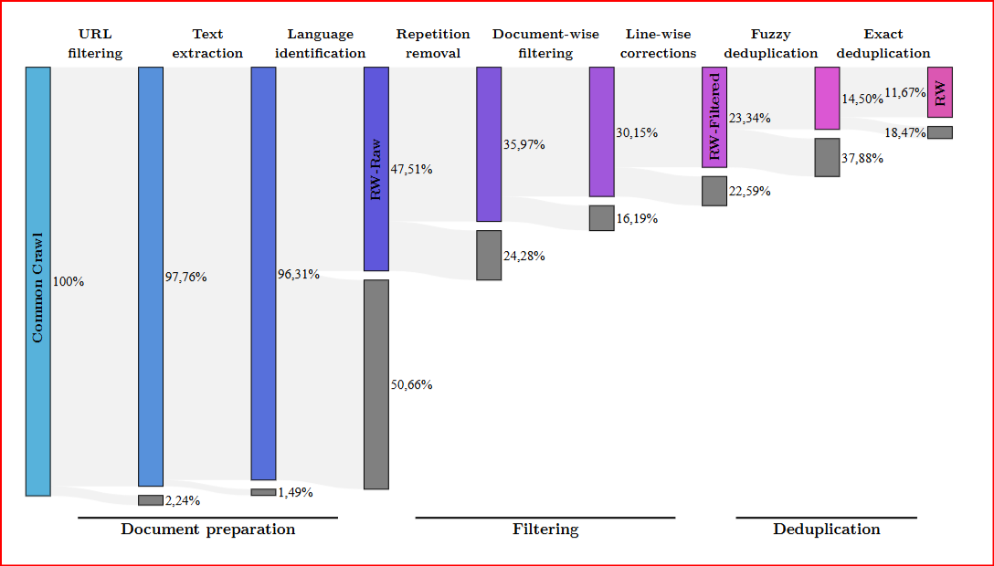
RefinedWeb Dataset

Slide 19

Why is Data Curation Important?
State-of-the-art data curation is essential for developing state-of-the-art models across all modalities
Higher Accuracy
TCO Savings
Faster Training
Task Specialization
Properly curated data leads to more improved accuracy across tasks
Decreases both training and inference costs significantly
Reduces compute requirements by orders of magnitude, enabling faster iterations
Enables optimization for specific tasks such as reasoning rather than general-purpose solutions
Notes:
State-of-the-art models depend on state-of-the-art data. High-quality data curation provides four key benefits:
Higher Accuracy: Curated data leads to better task performance across the board.
TCO Savings: By reducing noise, we lower both training and inference costs.
Faster Training: Clean data reduces compute needs, enabling faster iteration cycles.
Task Specialization: It allows us to fine-tune for specific objectives, like reasoning, instead of relying on generic models.
Curation isn’t just nice to have — it’s foundational to model success.

Slide 20
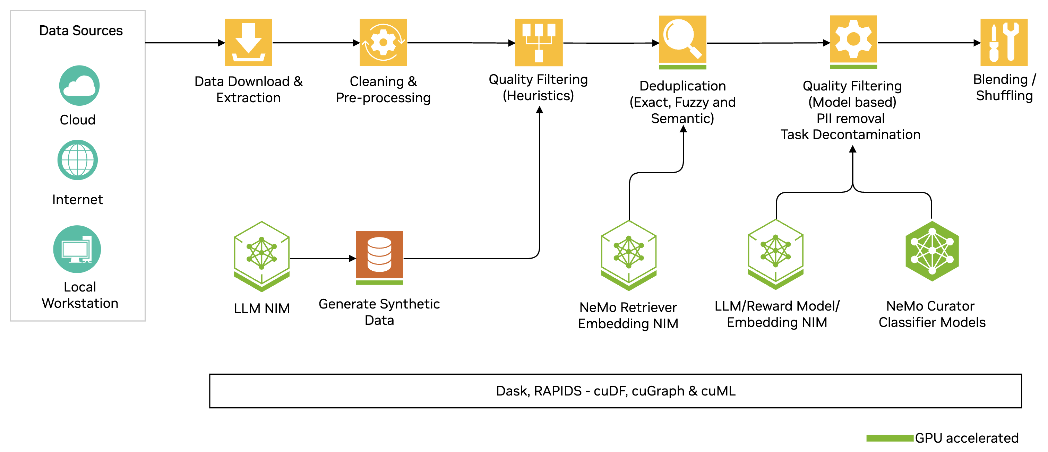
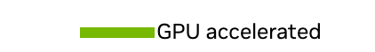
Introducing: NeMo Curator for Text Processing
Easily integrate different features into your existing pipelines with Python APIs
GitHub
NeMo framework container
PyPI
Notes:
NeMo Curator, open-source library on Github, available through pip install. And there is also a container available on build.nvidia.com. We take consideration of all the design criteria, it must be modular, and GPU accelerated.
If you look at the entire workflow, it is very modular, you can replace things in and out based on what your use case is. If you don’t need SDG, you don’t need to include it, if you don’t need a Quality Filtering, or Deduplication, you can bypass that step. If you have your own instruct model or reward model, you can plug that in. So you don’t have to stick with these modules, you can bring your own in-house modules as well and plug them into the workflow.
Under the hood, it was RAPIDS that got a lot of components which accelerated traditional libraries around there. It accelerated pandas, it helps replace scikit-learn with cuML which follows the same API normal features which scikit-learn has. cuGraph, it helps you accelerate if you have Graph repository dataset. A lot of components of this entire workflow, are accelerated using GPU accelerations, a lot of libraries inside RAPIDS.

Slide 21
NVIDIA NeMo Curator Pipeline
Taking NVIDIA Trained 43B as an Example
Size: ~250 TB Type: compressed (warc)
1
Time: ~3-6 hours
Dataset size: ~18 TB
After Heuristic based filtering data size: 6.2 TB
3
~108
hours
Internet Scale Datasets
Data Download + Detect language + Extract text
Text Re-formatting & Cleaning
Document-level Deduplication
(eng)
Document-level Quality filtering
Task Deduplication
After Exact deduplication (Common crawl) : 4.5 TB
Datasets : 3 (initial) + 17 = 20 Size: 8.6 TB
After Fuzzy deduplication Data size: 7.4 TB
4
Text downloaded: ~250 TB Detected languages: ~150 languages
Extracted Text (size): ~18 TB
2
Curated Data: ~8.9 TB
NMT data: 0.2 TB
Top 50 languages from CC-2022-40 (3.6 TiB)
Document-level Deduplication
(non-eng)
Document-level Quality filtering
Task Deduplication
After Fuzzy deduplication Data size: 2.4 TB
After heuristic filtering - top50 lang data size: 2.1 TB
Jp + Zh : 0.4 TB
Jp + Zh from mc4 (0.5 TB)

Slide 22
High Quality Data Processing Maximizes Model Performance
Data Curation helps build SOTA Models
LLM Accuracy Improvement on Curated Data
7.12%
Relative Accuracy Improvement Over Raw Data
4.29%
0.25%
Unicode Correction
Deduplication
Quality Filtering
Curation Method
Ablation on 357M Parameter GPT Model
Notes:
This chart highlights how data curation directly boosts LLM accuracy.
We ran an ablation study on a 357M parameter GPT model, and found:
Unicode correction gave a modest 0.25% lift.
Deduplication led to a significant 4.29% accuracy.
And most notably, quality filtering delivered a 7.12% accuracy boost in total.
This shows that even simple preprocessing steps — when done right — can drive state-of-the-art performance gains.

Slide 23
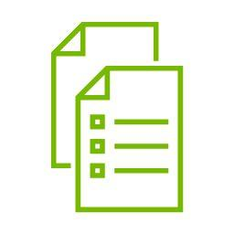


NeMo Curator: Features to Train Foundation Models
Achieve higher accuracy with a variety of GPU-accelerated features
Synthetic Data Generation
Deduplication & Classification
GPU Acceleration with RAPIDS
Pre-built pipelines - for tasks like prompt generation, dialogue generation, and entity classification
Modular - Easily integrate NeMo Curator's features into your existing pipelines
OpenAI API compatible - Integrate custom Instruct and Reward models
Lexical Deduplication – Identical (Exact) or near identical (Fuzzy)
Semantic Deduplication – focuses on the meaning rather than the exact text
Classifier Models - State-of-the-art open models to either enrich or filter your data.
cuDF - for deduplication & classifer models
cuML - for K-means clustering in semantic deduplication
cuGraph – for fuzzy deduplication
Notes:
NeMo Curator provides GPU-accelerated tools to improve data quality and training outcomes across three core areas:
Synthetic Data Generation: We offer pre-built pipelines for tasks like prompt generation, dialogue, and classification. It's modular and OpenAI-compatible, making integration easy.
Deduplication & Classification: Includes both lexical and semantic deduplication, along with classifier models to enrich or filter your dataset.
GPU Acceleration with RAPIDS: We use cuDF for processing, cuML for clustering, and cuGraph for fuzzy deduplication — enabling scalable, high-speed pipelines.
Together, these features help improve model accuracy while reducing compute cost and time to deployment.
------------------------------------------------------------------------------------------------------------------------------------------------------------------------------------------------------------------------------
Achieve higher training accuracy through accelerated processing for high-quality multi-modal datasets
Boost accuracy by processing high-quality text, image, and video data for pre-training, fine-tuning and RAG
Lower processing time by leveraging GPU-acceleration and scaling to multi-GPU multi-node
Improve model accuracy by generating high-quality synthetic data
Customizable and modular with open-source code
Pre-built pipelines - for tasks like prompt generation, dialogue generation, and entity classification
Modular - Easily integrate NeMo Curator's features into your existing pipelines
OpenAI API compatible - Integrate custom Instruct and Reward models
Classifier Models - State-of-the-art open models to either enrich or filter your data.
PII filtering – Removing PII information
cuML - for K-means clustering for domain classification
download extract
deduplication: lexical and semantic
filters: common filters? quality filtering by size for text, image, and video; similarity
image: image size
text: document size
video: clip length
CPU - m5.12xlarge - vCPUs: 48; Memory: 192 GiB, $2.3/hr on demand
GPU - p5.48xlarge, vcpus, $98.32/hr on demand

Slide 24
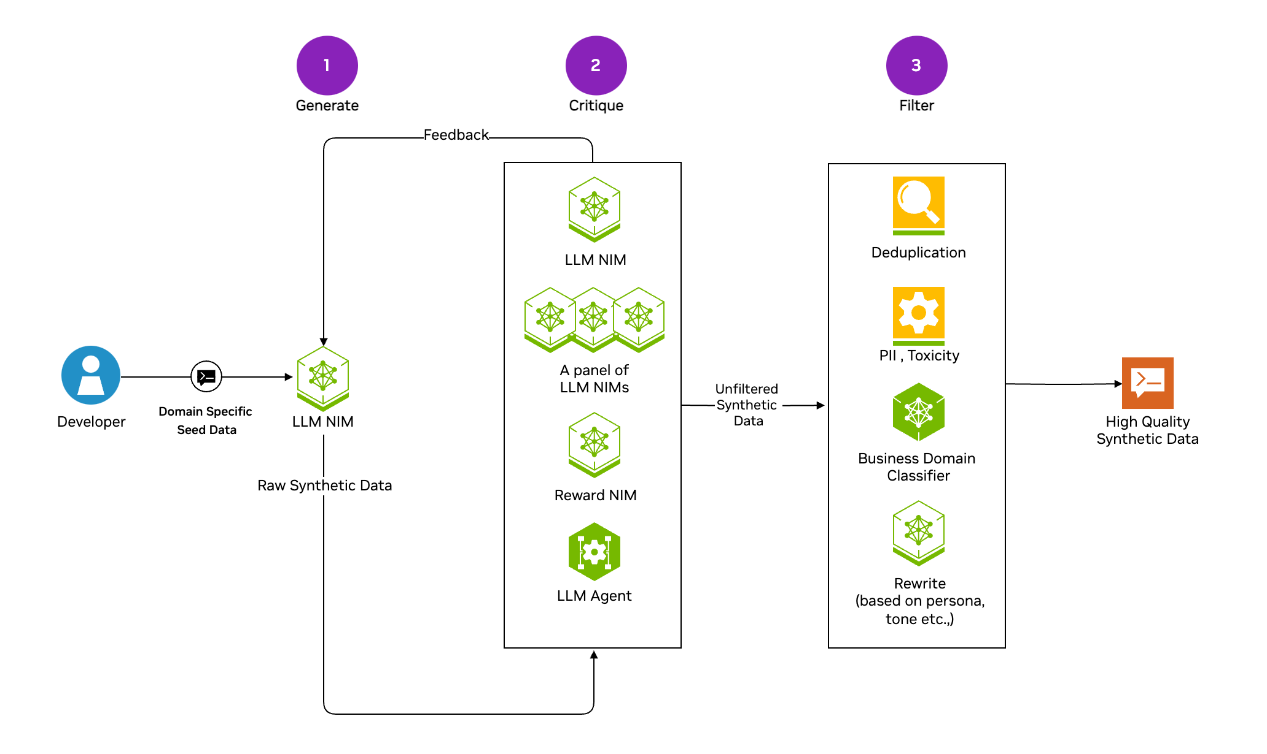
Synthetic Data Generation
Easily get started with pre-built pipelines or integrate various features into your existing workflows
Notes:
If you walk through the SDG whole process, the very first thing you need is the seed document. What I mean by a seed document is: If you are a financial institution and you need to generate synthetic data for your specific use case, it will have a different language than the general language model, the LLM model will have. So, you need to provide those documents as the seed documents and use the documents to give the query to the model so the LLM model will generate questions or synthetic data base on the seed documents you have provided.
And then you use a Critic model to evaluate the dataset, the Critic model can be one reward model, can be a penal of LLM models, can be an agent, depending upon how strict you want it to be. It is a reasonably well studied problem on what kind of LLM model or LLM agent we should use when we try to evaluate the data quality of the synthetic data generation.
Up to this step, the data is still unfiltered, and you still need to go through other steps that are important. You need to think if this fits my business domain use case, for example, if you are a financial institution, you need to remove the PII if seed documents have some personal information. You need to make sure the toxicity in the generation is in line with your expectation. All of these can be done manually, but it is just time consuming. There are automated tools out there you can use to verify all the information. Of course you want to run the deduplications as well.
After the three steps, that’s where you high quality synthetic data comes into place. Even if it is just one example of the entire workflow, you can see the complexity. This example has shown a lot of features that are modular features.

Slide 25
Synthetic Data Generation
Easily get started with pre-built pipelines or integrate various features into your existing workflows
Pre-built Pipelines
Llama 3.1 Nemotron 70B/340B Reward Model
Tooling Support
Prompt generation (open q/a, closed q/a, writing, math/coding )
Synthetic two-turn prompt generation
Dialogue generation
Entity classification
Benchmark-Topping Performance
Single scalar scoring for human preferences
Permissive license for commercial use
Integrate into existing pipelines
Bring your custom Instruct/Reward Model
Supports different filtering techniques
Notes:
Some of the things I want to highlight that are available off the shelf. In these examples, these are the supports available.
From the prompt and generation standpoint, it supports a lot of different ways you can think about, open qa, closed qa, writing, math/coding, entity classification, dialogue generation.
From the evaluation side, we released a Nemotron-340b reward model which produces a multi-dimensional scoring and nemotron-70b reward model which produces a single scalar score. They are available for commercial use and have been evaluated on a lot of benchmarks. Nemotron-70b has the highest rank on the board.
As for tooling support, we want to make sure it is modular enough, so you will not be stuck with using the modules we have provided; if you want to use your model, you should have the capability to do that as well; it is very modular and that’s the message I am trying to convey here.
------------------------------------------------------------------------------------------------------------------------------------------------------------------------------------------------------------------------------
Indicate the pre-built pipelines (7). Bring any model to generate , reward model, batch all calls – async generation. Remove the data with curator features.

Slide 26
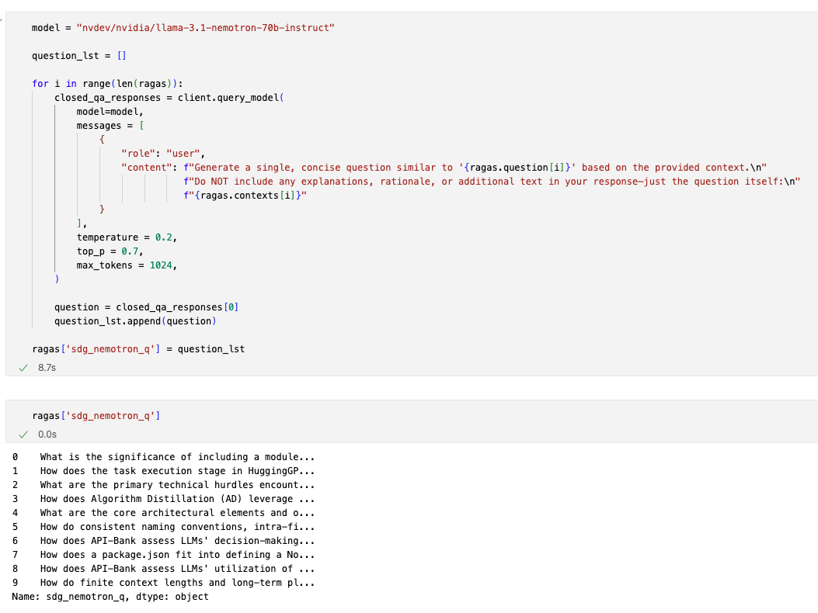
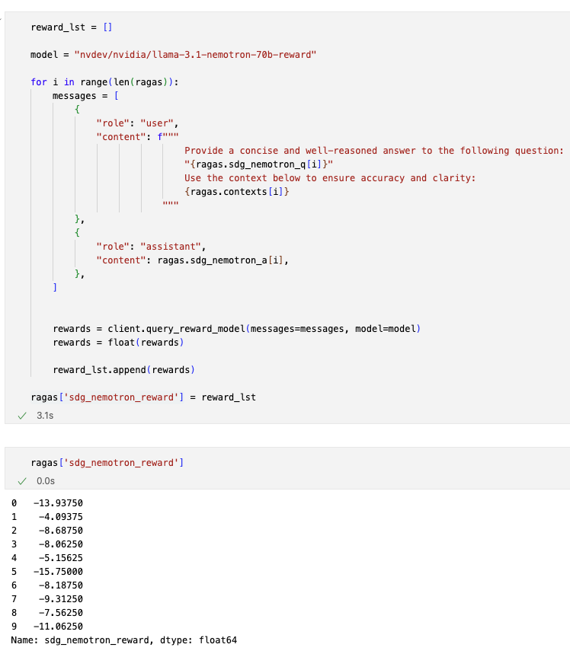
Synthetic Data Generation: Example
Use prompts to synthetically generate the QnAs and the reward score
QnAs generated
https://docs.nvidia.com/nemo-framework/user-guide/latest/datacuration/syntheticdata.html

Slide 27
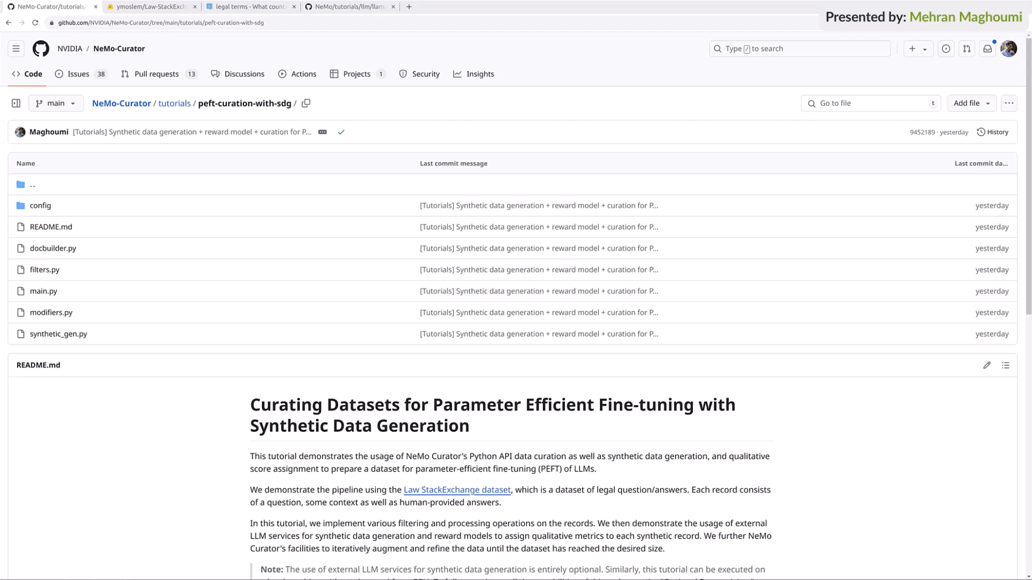
SDG Demo Video

Slide 28
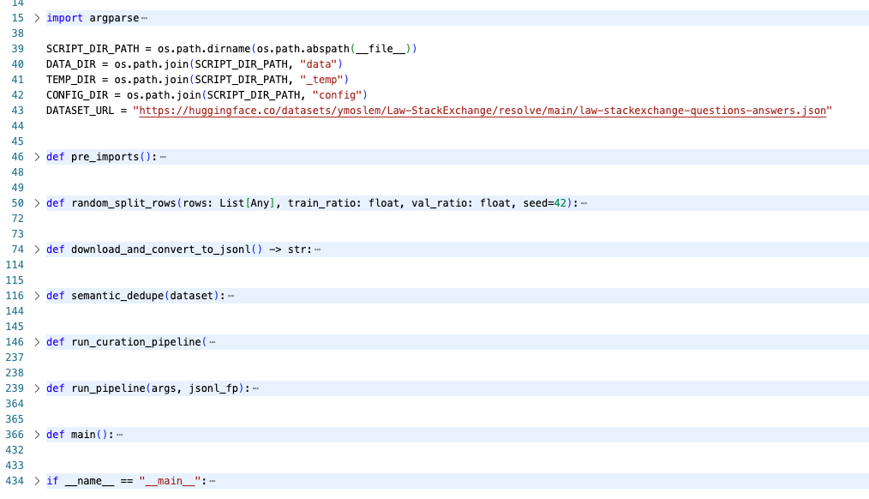
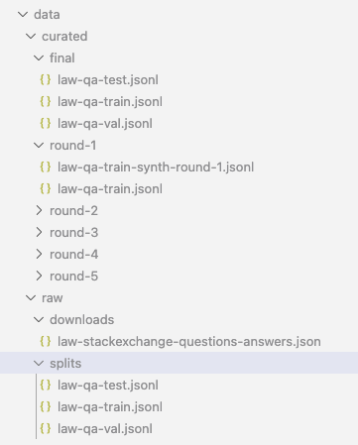
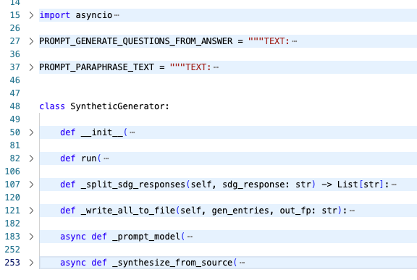
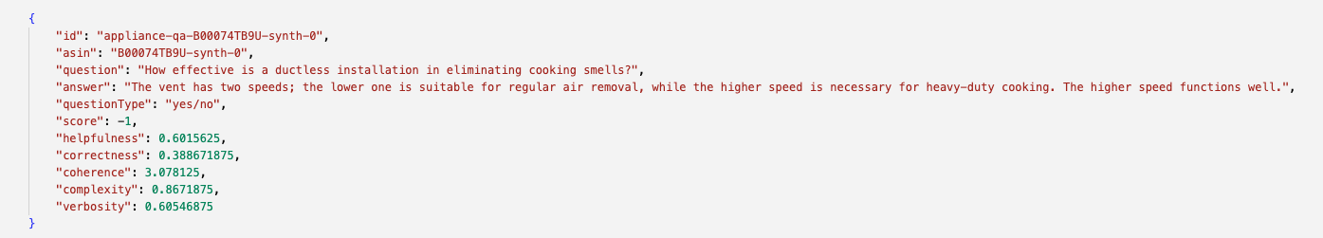
Synthetic Data Generation: Example
Build an SDG pipeline to generate the data
main.py
syn_gen.py
multiple rounds of SDG
one example on SDG curated result
https://github.com/NVIDIA/NeMo-Curator/tree/d401333ec9d88c36494befc9ae7515574c4d89fb/nemo_curator
Notes:
https://learn.nvidia.com/courses/course-detail?course_id=course-v1:NVIDIA+S-FX-27+V1

Slide 29
Deduplication and Filtering
Scale across multi-node, multi-GPU setups, eliminating the need for iterative CPU processing
Supports lexical and semantic deduplication for document processing
Scales on multi node, multi-GPU by leveraging RAPIDS
Scale to 100+ TB of data
Lexical Deduplication
Semantic Deduplication
Acceleration
Utilizes text similarity to discover duplication
Exact deduplication
Hashing based matching for each document
Fuzzy deduplication
Minhash, Bucketization and Clustering
Utilizes meaning of text to discover duplication
Leverages embedding models to identify semantic documents
Modularity to use custom embedding model
Accuracy Improvement vs No curation
4.29%
0.25%
Unicode Correction (fify)
+ Deduplication (Fuzzy & Exact)
357M GPT model using deduplication, heuristic filtering, and unicode correction
Notes:
The next step is how to remove duplications from documentation and filter it out. There are two levels we should remove the duplications, the lexical duplication and the semantic duplication.
Semantic Deduplication has the embedding model to do the similarity score search, jaccard similarity, cosine similarity and use that to remove semantically similar documents from the dataset. So I talk about different methods you can use, clustering is one of the important methods, which is accelerated using cuML library under the hood.

Slide 30
NeMo Curator - Deduplication
Scale across multi-node, multi-GPU setups, eliminating the need for iterative CPU processing
Value Proposition
Technical Details
Lexical Deduplication
Accelerate on multi-node multi-GPU setups by leverage RAPIDS
Scale up to 100+ TBs of data
Get support for both
Lexical Deduplication: Uses text similarity, both Exact and Fuzzy
Semantic Deduplication: Uses text meaning
Exact deduplication
Hashing for each document
Fuzzy deduplication
Minhash, Bucketization and Clustering
Semantic Deduplication
Leverage embeddings to identify semantic documents
Use SOTA NeMo Retriever Text Embedding NIM or customize with your embedding model

Slide 31
NeMo Curator - Classifier Models
Create high-quality data blends with RAPIDS accelerated inference
Value Proposition
Classifier Models
Accelerated inference with RAPIDS powered distributed data classification module and intelligent batching
Seamless scalability for classifying TBs of data
Faster processing with parallelization across multiple GPUs
Lower memory and compute footprint with state-of-the-art open classifier models (Apache 2.0 license )
8 classifier models released
Domain Classifier
Supports 26 domain classes
Top 10 classes : Finance, Health, Business and Industrial, Science, Law and Government, Internet and Telecom, Jobs and Education, News, Computers and Electronics, Shopping;
Trained on 1 million Common Crawl samples & 500k Wikipedia articles
Also available for multiple languages
Quality Classifier
Classify quality of the document to ‘High’, ‘Medium’ or ‘Low’
Training data annotated by humans on quality factors such as: content accuracy, clarity, coherence, grammar, depth of information and overall usefulness of the document

Slide 32
NeMo Curator - Classifier Models
Create high-quality data blends with RAPIDS accelerated inference
Prompt Task and Complexity Classifier
Content Type Classifier
Classify tasks across 11 categories
OpenQA, Closed QA, Summarization, Text Generation, Code Generation, Chatbot, Classification, Rewrite, Brainstorming, Extraction, Other
Compute complexity on 6 dimensions
Creativity, Domain Knowledge, Reasoning, Constraints, Contextual Knowledge, # of Few shots
Categorize documents into 11 content types
Explanatory articles, News, Blogs, Boilerplate content, Analytical exposition, Online Comments, Reviews, Books & literature, Conversational, and Personal Websites.
Useful for content management systems, digital publishers, recommendation systems
FineWeb Nemotron-4 Edu Classifier
Instruction Data Guard
Determine the educational value of a piece of text (score 0-5 from low to high).
Trained using annotations from Nemotron-4-340B-Instruct
Identify malicious prompts used for fine-tuning
Optimal use for instruction:response datasets

Slide 33
Performance – Fuzzy Deduplication
~16x Faster Processing
Near Linear Scaling
10.7
2.05
~16x faster
Processing Time (hrs)
Processing Time (hrs)
0.94
0.65
0.5
Curator Off
Curator ‘On’
1
2
4
H100 nodes 80GB
Processing time for fuzzy deduplication of RedPajama-v2 subset (8TB/1.78T tokens)
Processing time for fuzzy deduplication of RedPajama-v2 subset (8TB/1.78T tokens)
‘On’: Data processed with NeMo Curator on 3 H100 nodes
‘Off’ : Data processed with a leading alternative library on CPUs
Scaling on 1, 2, 3, 4 H100 nodes 80GB
Notes:
This slide shows the performance advantage of using NeMo Curator for fuzzy deduplication.
On the left, we see a ~16× speedup — going from 10.7 hours with a CPU-based method to just 0.65 hours using Curator on 3 H100 GPUs.
On the right, we show how processing time scales efficiently with more GPUs — dropping to just 0.5 hours on 4 H100 nodes.
This demonstrates the impact of GPU acceleration and scalable architecture for handling large-scale data cleaning — in this case, an 8TB dataset with 1.78 trillion tokens.

Slide 34
Deep Dive: Fuzzy Deduplication
Identifying similar documents
Exact Duplicate: “We the People of the United States, in Order to form a more perfect Union, establish Justice…”
Fuzzy Duplicate: “Here is the US Constitution. We the People of the United States, in Order to form a more perfect Union, ensure Justice…”
Fuzzy Duplicate: “We the People of the United States, in Order to ensure Justice and domestic tranquility…”
Document: “We the People of the United States, in Order to form a more perfect Union, establish Justice…”
Notes:
This slide illustrates how fuzzy deduplication identifies similar but not identical documents.
On the left is our original document.
On the right, the exact duplicate matches word-for-word.
The fuzzy duplicates, however, have small differences — like added context or minor word changes — but still carry the same semantic meaning.
Fuzzy deduplication helps eliminate this kind of near-duplicate content, which is critical for improving training data quality and reducing redundancy in foundation models.

Slide 35
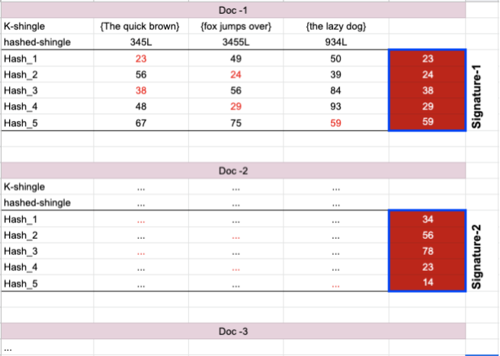
Min-hashing
Src: https://mrhasankthse.github.io/riz/2020/03/19/Minhash-and-LSH.html

Slide 36
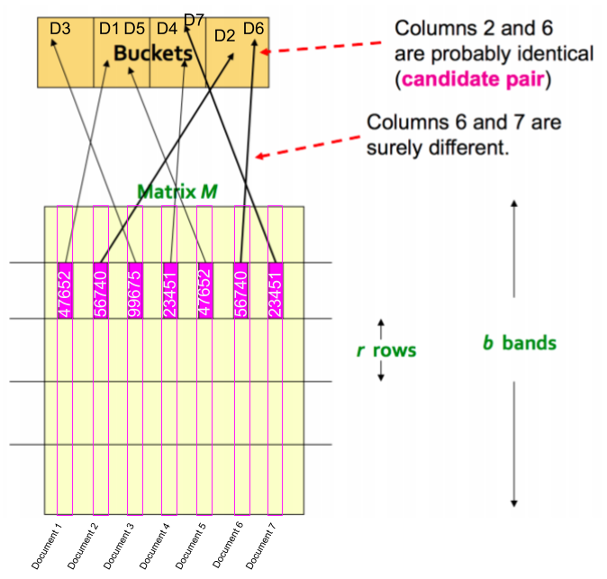
Signatures over hash buckets
Src: https://mrhasankthse.github.io/riz/2020/03/19/Minhash-and-LSH.html
Notes:
divide the document signature into a number of chunks or bands. Now (fig:2) you can take a chunk (i.e. band) from a random location of a signature and compare it with a chunk (i.e. band) taken from the same location of another signature. You can map all the similar local chunks to some hash buckets - then each bucket will give you an approximate similarity of the signatures within

Slide 37
Deep Dive: Fuzzy Deduplication
Min-Hashing and Bucketization
Document 1: “We the People of the United States, in Order to form a more perfect Union, establish Justice, ensure domestic Tranquility, provide for the common defense, promote the general Welfare, and secure the Blessings of Liberty...”
Document #1
Document #1
Bucket #1
Bucket #2
Bucket #3
Bucket #4
Notes:
This slide explains how we use min-hashing and bucketization to efficiently find similar documents.
Here, Document 1 is broken into smaller hashed representations and assigned to multiple buckets based on content similarity.
By grouping documents that land in the same buckets, we can quickly and scalably detect near duplicates — even across massive datasets — without comparing every document to every other one.
It’s a key technique for making fuzzy deduplication performant at scale.

Slide 38
Deep Dive: Fuzzy Deduplication
Min-Hashing and Bucketization
Document 2: “Here is the US Constitution. We the People of the United States, in Order to form a more perfect Union, establish Justice, insure foreign Tranquility, provide for the common defense, promote the general Welfare, and secure the Blessings of Liberty...”
Document #1
Document #2
Document #1
Document #2
Bucket #1
Bucket #2
Bucket #3
Bucket #4
Notes:
Document 2 has some differences — highlighted in red — but still shares enough content with Document 1 to land in the same bucket (#1).
By comparing only documents that fall into the same buckets, we dramatically reduce the number of comparisons needed — making fuzzy deduplication scalable and efficient even for massive datasets.

Slide 39
Deep Dive: Fuzzy Deduplication
Min-Hashing and Bucketization
Document 3: “We the People of Canada, in Order to form a more perfect Union, establish Justice, insure domestic Tranquility, provide for the common defense, promote the general Welfare, and secure the Blessings of Liberty...”
Document #1
Document #2
Document #1
Document #2
Document #3
Document #3
Bucket #1
Bucket #2
Bucket #3
Bucket #4
Notes:
This example shows how Document 3, while slightly different — for example, 'People of Canada' instead of 'United States' — still shares a significant amount of content with Documents 1 and 2.
As a result, it's placed in overlapping buckets (#2 and #3), alongside other similar documents.
This illustrates how min-hashing and bucketization allow us to group near-duplicates efficiently, even when there are subtle variations in wording or structure.

Slide 40
Deep Dive: Fuzzy Deduplication
Min-Hashing and Bucketization
Document #1
Document #2
Document #1
Document #4
Document #2
Document #3
Document #3
Bucket #1
Bucket #2
Bucket #3
Bucket #4
Duplicates
Notes:
Documents that share similar content end up in the same buckets — and by analyzing overlaps across buckets, we can confidently identify clusters of duplicates.
Here, Documents 1, 2, and 3 repeatedly co-occur across Buckets 1, 2, and 3 — indicating they’re duplicates. Document 4, which appears in Bucket 4 only, is considered unique.
This method dramatically reduces computation while accurately detecting both exact and fuzzy duplicates at scale.

Slide 41
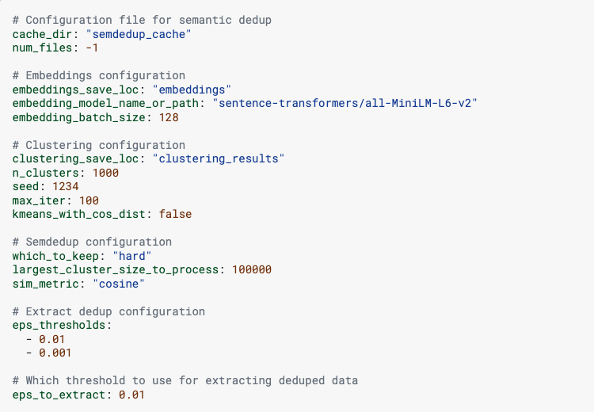
Semantic Deduplication: Example
Remove redundant data by identifying and eliminating semantically similar data points
sem_dedup_config.yaml
https://docs.nvidia.com/nemo-framework/user-guide/latest/datacuration/semdedup.html
Notes:
This is an example configuration file used for semantic deduplication.
We use sentence embeddings to capture meaning — in this case, generated with a MiniLM model — and then perform clustering to group semantically similar documents.
Key parameters include:
Number of clusters, embedding batch size, and similarity metric (cosine)
Thresholds for identifying near-duplicates and extracting cleaned data
This YAML config makes it easy to customize deduplication at scale using embeddings + clustering — all GPU-accelerated with NeMo Curator.
And you do need embedding model to find document similarity, it is modular enough that you can bring your own model if you don’t want to use the default model we have provided. You can bring in the model from anywhere, if that is hugging face model, you can use that, if you build your own embedding model, you can use that as well. And at each stage, im going to show the improvement you are getting for the overall accuracy.

Slide 42
Classification and PII
Create high-quality data blends with RAPIDS accelerated inference
Accelerated inference through distributed classification model and intelligent batching
Redact/remove Personally Identifiable information (PII) using SOTA model
Classification
Mask/remove PII
Acceleration
Domain Classifier
Model trained on 1.5 million samples
Classifies text in 26 domain classes
Document Quality Classifier
Classifier quality of document in ‘High’, ‘Medium’, ‘Low’ categories
Enables document quality check
Remove sensitive information from data
Utilizes State-Of-The-Art spacy model to remove PII information
7.12%
Accuracy Improvement vs No curation
4.29%
0.25%
Unicode Correction (fify)
+ Deduplication (Fuzzy & Exact)
+ Quality Filtering
357M GPT model using deduplication, heuristic filtering, and unicode correction
Notes:
Last piece I would like to share is Classification and PII removal.
Classification can be two different kinds, and the one we have implemented is called Document Quality Classifier and classified into 3 buckets, high, medium, and low. And based on the dataset size, the bar can be varied. If you have a lot of data, you can be very strict… Another classifier you have is domain level classifier, and we have already created model that is available for you to use, as part of the NeMo curator library, it categorizes the text into 26 domain classes.
The other one I have already mentioned is Masking or PII removal. We are not using our own model in the NeMo curator; we are using the spacy model created by MS, available for all of us to use. As we go through the pipeline of classification and PII removal, we see another bump in the overall accuracy. This is all accumulative.

Slide 43
Accelerated Data Processing Maximizes LLM Performance & Scale
Nemo Curator: Up to 7% better Accuracy for LLM Downstream Tasks
Scale to 100+ TB of data
7.12%
3.4
Accuracy Improvement vs No curation
Processing Time (hrs)
4.29%
1.7
0.9
0.25%
0.5
Unicode Correction (fify)
+ Deduplication (Fuzzy & Exact)
+ Quality Filtering
1
2
4
8
H100 nodes 80GB
357M GPT model using deduplication, heuristic filtering, and unicode correction
Scaling Fuzzy Deduping 1.2T tokens
(RedPajama-v1)
Notes:
To summarize, two messages about NeMo Curator here,
one is by removing bad quality data through the workflow by doing Unicode correction, deduplication, and document quality filtering, we see increase in overall accuracy from the model.
And scalability, once you train your model on a single GPU, and you have a lot of data and you want to scale it to 8 GPUs or a node, you are going to see an improvement in your overall processing time. That is the second message here.
------------------------------------------------------------------------------------------------------------------------------------------------------------------------------------------------------------------------
Achieve higher training accuracy through accelerated processing for high-quality multi-modal datasets
Boost accuracy by processing high-quality text, image, and video data for pre-training, fine-tuning and RAG
Lower processing time by leveraging GPU-acceleration and scaling to multi-GPU multi-node
Improve model accuracy by generating high-quality synthetic data
Customizable and modular with open-source code
download extract
deduplication: lexical and semantic
filters: common filters? quality filtering by size for text, image, and video; similarity
image: image size
text: document size
video: clip length
CPU - m5.12xlarge - vCPUs: 48; Memory: 192 GiB, $2.3/hr on demand
GPU - p5.48xlarge, vcpus, $98.32/hr on demand

Slide 44
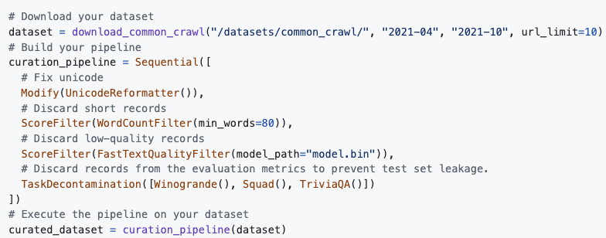
NeMo Curator: Example
GitHub
NeMo framework container
PyPI
Notes:
These are all helpful when you are trying to design your data workflow. And how easy or hard it is to do that? Like Keras, you just create your own graph, and you can run the pipeline, and it got executed. It is very modular as you can remove functions you don’t care about, and you can keep it there if you care. Again, you can bring in your own module if you like.
------------------------------------------------------------------------------------------------------------------------------------------------------------------------------------------------------------------------
RAPIDS brings GPU acceleration to the open-source data science and data engineering ecosystem.
Making accelerated computing more seamless (through integrations with CPU tools) while enabling deep customization for maximum performance (with GPU-specific tools)
But it only works if we go end to end. This is a core pillar. Start with a friendly library like cuDF in Python. Or you can use that same optimized core in Apache Spark and take your Spark SQL/DataFrame.
But we need to work with DLFWs or traditional ML models and graph analytics. Then we need to think about deployment. Build a great model, but you need to hit latency SLAs to deploy it in production. So we’ve optimized that process too. And it all needs to fit into the modern world of vector search and LLMs. RAFT enables that.
This is all unified together on top of NVAIE, and pretty much all of the tools are open source and play well together.

Slide 45
NeMo Curator - Resources
Getting Started
Tutorials & Blogs
NeMo Framework Container
GitHub
PyPI
Installation Guide
Developer Page
User Guide/ Docs
API Docs
Classifier Models
Examples
Best Practices
Bugs
Discussions
Curating data for PEFT (Blog)
Curating synthetic data for PEFT
SDG using Llama 3.1 405B & Nemotron 4-340B
SDG using Nemotron 4-340B
Pre-training / DAPT
Fine-tuning
Curating data for LLM training (Blog)
Curating non-English data (Blog)
How-to run classifier models
All blogs
Notes:
To help you get started and go deeper with NeMo Curator, we’ve organized resources into three key categories:
Getting Started: Links to the container, GitHub, PyPI, installation guide, API docs, classifier models, and more.
Tutorials & Blogs – Pretraining: Step-by-step guides for curating LLM training data, handling non-English corpora, and running classifier models.
Fine-tuning: Covers PEFT workflows, synthetic data curation, and large-scale SDG examples using LLaMA 3.1 and Nemotron 4-340B.
You’ll find everything from how-to blogs to best practices and examples — all available in the docs or discussion forums.

Slide 46
Image Processing

Slide 47
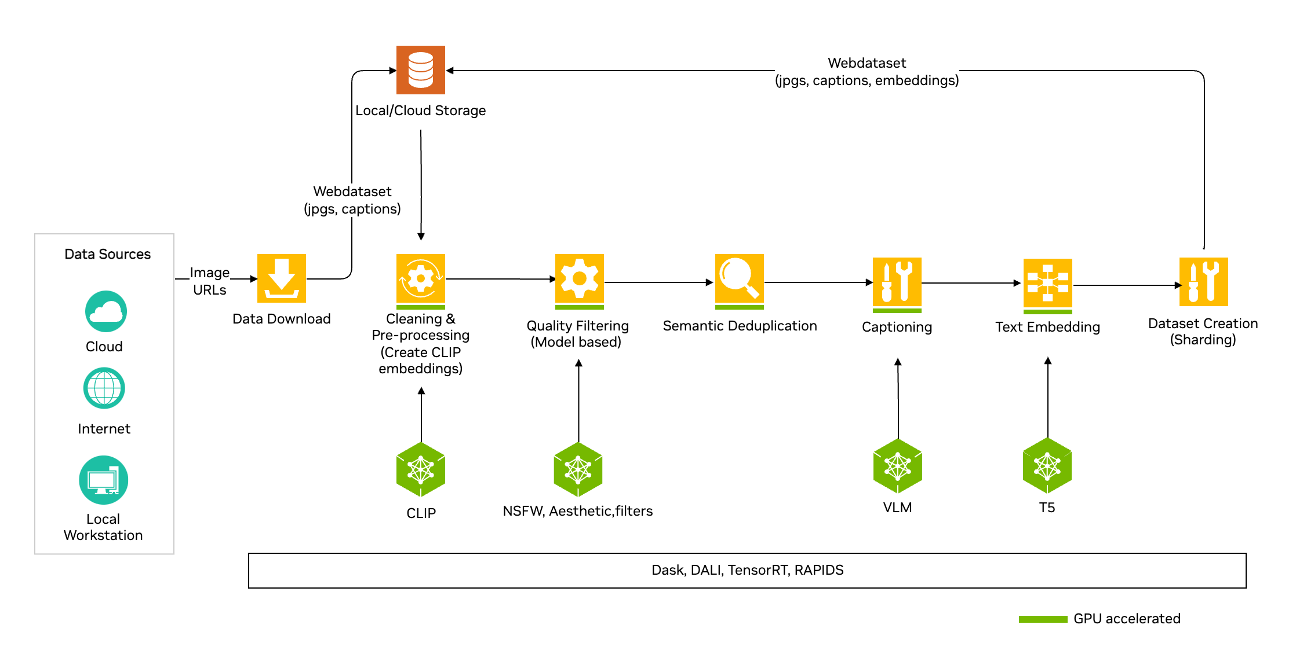
NeMo Curator Architecture: Image Processing
Notes:
This diagram outlines the end-to-end pipeline for curating image datasets using NeMo Curator.
It starts with image URLs from cloud, internet, or local sources.
Images are downloaded, then preprocessed and embedded using CLIP.
Next, we run quality filtering with models for NSFW, aesthetic, and other checks.
We apply semantic deduplication, then generate captions using a VLM and text embeddings via T5.
Finally, data is sharded and packaged into a WebDataset for training.
The entire workflow is GPU-accelerated with RAPIDS, DALI, TensorRT, and Dask — enabling scalable, high-performance image curation.

Slide 48
Video Processing

Slide 49
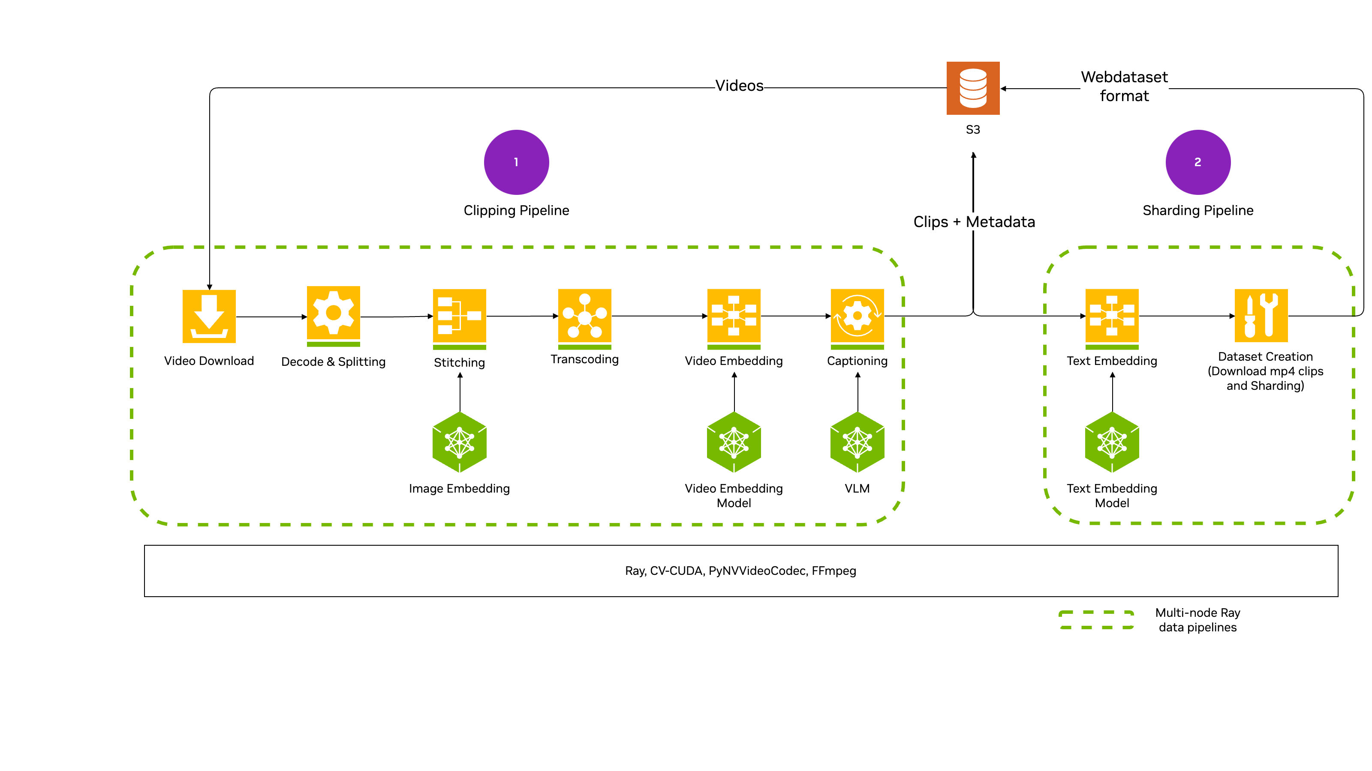
Video Curation: EA Features
Notes:
This diagram shows NeMo Curator’s video curation pipeline, optimized for scalability and performance.
We start by downloading and splitting raw video content, then stitch and embed keyframes using CLIP. Next, we transcode the clips, apply video embeddings, and generate captions using a vision-language model.
Finally, we embed the text and shard everything into a WebDataset format — ready for training.
All steps are GPU-accelerated and run on multi-node Ray pipelines for massive-scale throughput.
------------------------------------------------------------------------------------------------------------------------------------------------------------------------------------------------------------------------------
The chart represents our end to end Video Curator managed service architecture that we will be offering in DGX Cloud.
Data curation involves taking millions of raw videos and then processing them through a series of AI models to find really high quality clips that can be used to train a Video Foundation Model. The stages involve -
Splitting the videos in semantically relevant shorter clips and transcoding them
Running a series of filtering algorithms to identify the high quality clips
Motion estimation, watermark, aesthetic score, etc.
Annotation - Auto labeling of captions for the clips using a VLM (Vision Language Model)
Embedding - create video embeddings used later for training or downstream RAG use cases
Other data understanding steps like segmentation (identify parts of the video with specific objects), depth/camera trajectory estimation, etc.
Semantic deduplication - remove videos that are semantically similar
Dataset creation - create a high-quality dataset for training

Slide 50
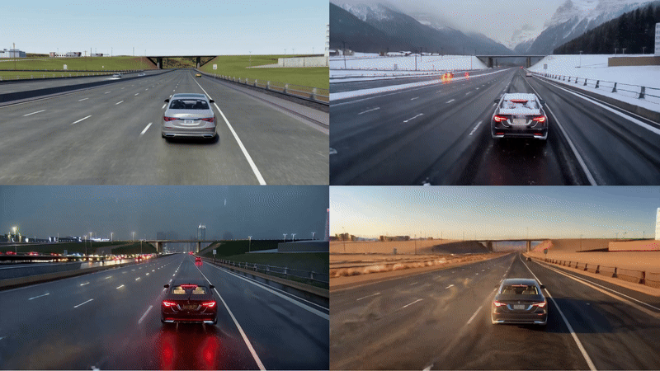
State of the Art Models
Example Use case: Generate new lighting, weather, and geolocations

Slide 51
Best Practices
Choosing the Right Quality Model Type
Handling GPU Out-of-Memory (OOM) Errors
Controlling Partition Sizes
Fuzzy Deduplication Guidelines
Reduce bucket counts
Reduce buckets per shuffle
Adjust files per partition
GPU Memory and Utilization – Dask Dashboard
Notes:
fastText is an n-gram based bag-of-words classifier. It is typically trained on a high quality reference corpus and a low quality corpus (typically unfiltered Common Crawl dumps). BERT-style classifiers - NeMo Curator’s distributed data classification modules work with many BERT-style classifiers for domain classification, quality classification, and more. Language model labelling - Language models can be used to label text as high quality or low quality. Reward model labelling - Unlike the previous methods, reward models label the quality of conversations between a user and an assistant instead of labelling the quality of a document.
The user should consider using files_per_partition or blocksize when reading data. This can help reduce the memory load by processing large datasets in smaller chunks.
Increasing the number of buckets increases the probability that two documents within a given Jaccard similarity score are marked as duplicates. However, increasing the number of buckets also increases the memory requirements from the increased number of hashes it needs to store. Thus, it is important to find an optimal balance between memory usage and deduplication accuracy The user may also need to change the hashes_per_bucket parameter to match the same Jaccard threshold being aimed for. Think of it like this: with a high num_buckets and low hashes_per_bucket Processing large datasets in smaller chunks can help reduce the memory load.

Slide 52
Register for GTC 2026
https://tinyurl.com/nvgtc2026
Scan QR

